Slide 1
I Believe Jesus Christ Is The Son Of God
Acts 8:36-37
“And as they went on the way, they came unto a certain water; and the eunuch saith, Behold, (here is) water; what doth hinder me to be baptized? (And Philip said, If thou believest with all thy heart, thou mayest. And he answered and said, I believe that Jesus Christ is the Son of God.”

Slide 2
Everybody is going somewhere …
These two were on the road to Emmaus. “And behold, two of them were going that very day to a village named Emmaus, which was about seven miles from Jerusalem.” Luke 24:13 NASU
Saul was on the road to Damascus. “And as he journeyed, it came to pass that he drew nigh unto Damascus: and suddenly there shone round about him a light out of heaven” Acts 9:3
The Ethiopian eunuch was on the road to Gaza. “But an angel of the Lord spake unto Philip, saying, Arise, and go toward the south unto the way that goeth down from Jerusalem unto Gaza: the same is desert.” Acts 8:26

Slide 3
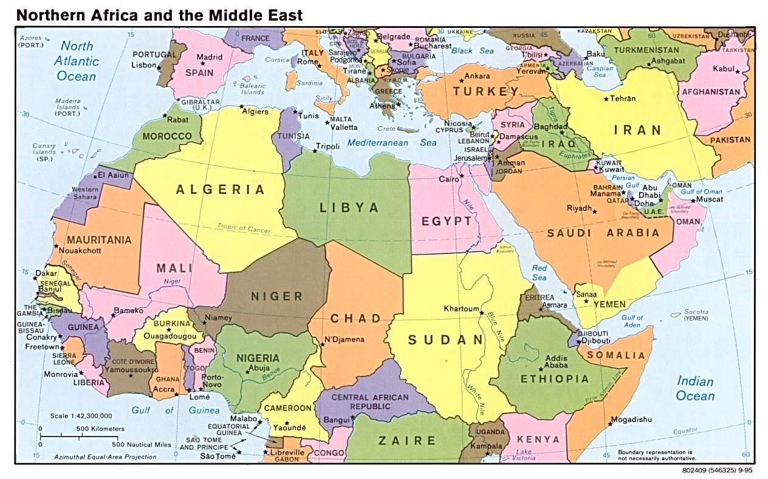
1,000 miles
CUSH
ETHIOPIA

Slide 4
Confessing Jesus’ Identity.
Matthew 10:32; Romans 10:9-10
When one confesses Jesus, what is he saying he believes?
Jesus is the Christ, the Messiah promised by God’s prophets. John 9:22
God raised Jesus from the dead to be Lord.
Romans 10:9; Philippians 2:9-11
Jesus is the Son of God, He is God.
1 John 4:15
Jesus is the Son of Man. Jesus the Christ is come in the flesh. 1 John 4:2-3; 2 John 7

Slide 5
Proving Jesus’ Identity
What Is The Evidence?
1 Thessalonians 5:21, “Prove all things; hold fast that which is good.” (cf. 1 Peter 3:15)
John 5:31, “If I bear witness of myself, my witness is not true.” (cf. Deuteronomy 19:15; John 8:17; 2 Corinthians 13:1;
1 Timothy 5:19).
  Many witnesses which proved His identity.
  John 5:32-47

Slide 6
Proving Jesus’ Identity
The Witness Of The Scriptures.
Prophecies of His birth … fulfillment.
Prophecies of His character … fulfillment.
Prophecies of His ministry … fulfillment.
Prophecies of His betrayal, trial, and crucifixion … fulfillment.
Prophecies of His resurrection and exaltation … fulfillment.

Slide 7
Proving Jesus’ Identity
The Witness Of The Scriptures. Acts 8:35
Jesus used this evidence. Luke 24:44; cf. Matthew 5:17-18; 26:56; Luke 4:20-21; 24:27; and John 5:39-40, 46-47
Apostles used this evidence. Acts 3:18, 24; 7:52; 10:43; 13:29; 17:2-3; 26:22-23; 28:23; 1 Peter 1:10
Some argue Jesus either deliberately or coincidentally fulfilled the prophecies. How could it be when many prophecies Jesus fulfilled were outside any human control?
  The manner of his conception. Isaiah 7:14
  The time of his birth. Genesis 49:10
  The place of his birth. Micah 5:2
  The manner of his death. Psalms 22:16

Slide 8
Proving Jesus’ Identity
The Witness Of Miracles. John 5:1ff, 36
  Nicodemus. John 3:2
  Jesus to the multitude. John 6:1ff
  Jesus’ confrontation of the Jews. John 10:24-25, “How long dost thou hold us in suspense? If thou art the Christ, tell us plainly. Jesus answered them, I told you, and ye believe not: the works that I do in my Father's name, these bear witness of me.” cf. John 10:37-38; 15:24
  Inquiry of John the Baptist. Luke 7:20-22
  Apostles’ use of the miracles.
    Peter to Jews on Pentecost. Acts 2:22
    Peter to Cornelius. Acts 10:38
    Paul to Agrippa. Acts 26:26

Slide 9
Proving Jesus’ Identity
The Witness Of The Resurrection. Romans 1:4
Preached by Jesus.
  As He began His ministry. John 2:18-22
  Throughout His ministry. Matthew 16:21; 17:9, 22-23; 20:17-19; 26:31-34
Preached by the apostles.
  Peter. Acts 2:32; cf. Acts 2:23-31; 3:15, 26; 10:40-41
  Paul. Acts 13:30; cf. Acts 13:34-37; 17:31
The very passage the eunuch was reading foretold of the Christ's death. Acts 8:32-33
No other life in ancient history has more historical documentation and evidence, than the life of Jesus of Nazareth.

Slide 10
Conclusion:
The Ethiopian eunuch had heard the “witnesses.”
Acts 8:35-39, “And Philip opened his mouth, and beginning from this Scripture, preached unto him Jesus. And as they went on the way, they came unto a certain water; and the eunuch saith, Behold, (here is) water; what doth hinder me to be baptized? (And Philip said, If thou believest with all thy heart, thou mayest. And he answered and said, I believe that Jesus Christ is the Son of God.) And he commanded the chariot to stand still: and they both went down into the water, both Philip and the eunuch, and he baptized him. And when they came up out of the water, the Spirit of the Lord caught away Philip; and the eunuch saw him no more, for he went on his way rejoicing.” cf. Romans 6:3-4

